Slide 1
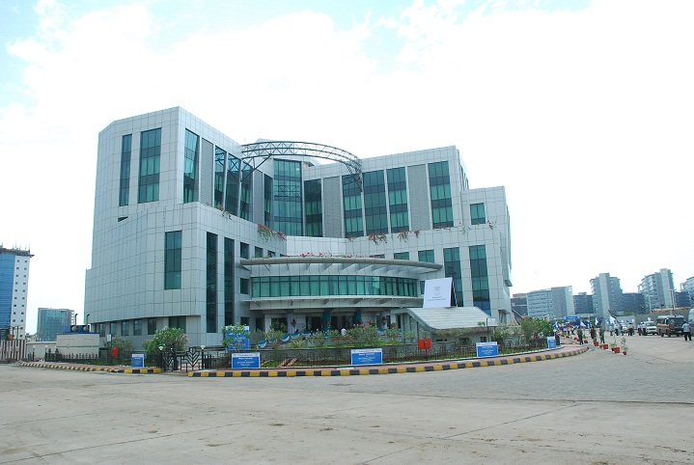
Greetings
To
Delegates
“Bancassurance
& Beyond”

Slide 2
Bancassurance – ( Non Life)
Synergy Or Conflict ????
K Sanath Kumar , GM, New India Assurance

Slide 3
Bancassurance (in non life Insurance)
Banks & General Insurance Company’s are very old business associates.
A significant part of income of non life insurers were Bank driven
The Rural development initiatives of 80’s and early 90s such as IRDP, DRDA were driven by Bank – insurer partnership
The Relationship of Life insurers and Banks started growing after 2001 when the regulations came.
Only the term Bancassurance is rather new.

Slide 4
Bancassurance (in non life Insurance)
Banks have insurable interest in the assets on which they have give credits & assets pledged to them.
They can fill the proposal forms and pay premium . KYC can stop with them . We have mortgage clause , Hypothecation clause.
All Bank Branches where credit business is done , will certainly have a non life Insurance Policy
Bank Managers are fairly conversant with General insurance
No major instances of mis-selling or forced selling

Slide 5
Stages of Bancassurance
1) Assets created by Credit
2) Collaterals & Security
3) Loanees, Credit/ debit/ Kisan Card holders , Account holders
5) Data Base Exchange
4) Other assets of the Credit customers and new Customers , Cross selling

Slide 6
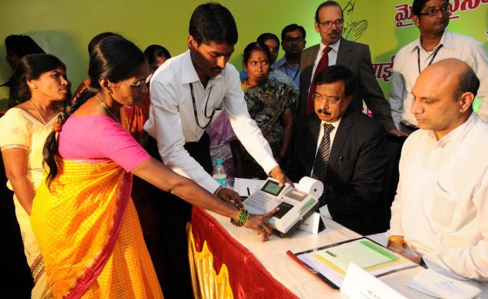
IT Driven Business platforms
Master details available at Central offices of Banks and can be placed for Insurance
The Financial inclusion Model ( Business correspondents / Customer service person / Hand held devices )
Insurance covers embedded in Debit/ ATM/ Credit Cards
Insurance from ATMs / Renewal facility
Web Based Insurance interfaces

Slide 7
Synergy
Despite the banks promoting and co-owning the Insurance Companies in General insurance , they are no distortion .
The collaboration and symbiosis between banks & General Insurers are need based, long lasting and integral part of the Financial services system .
The large number of Bank branches & the reach, Swabhiman project & financial inclusion , the priority lending, the operational risk management needs of the Bank etc would need strong insurance support .

Slide 8
Thank You

Slide 9
Strategies

